Slide 1
Sharon Starick Presiding Member, SA Murray Darling Basin Natural Resources Management Board

Slide 2
Importance of River Murray
What does the Basin Plan mean for South Australia?
What does it mean for our region and communities?
What are we doing in South Australia?

Slide 3
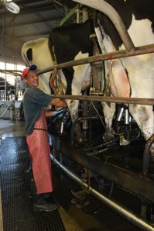
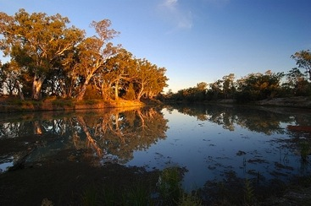
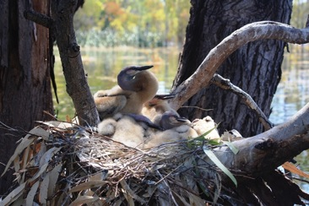
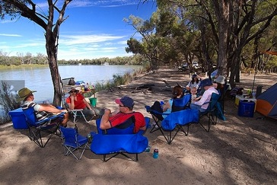
The River is the
life-blood of SA
Environmental
Cultural
Social
Economic

Slide 4
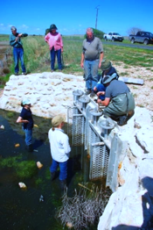
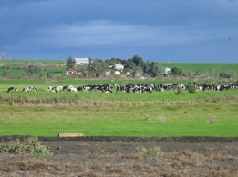
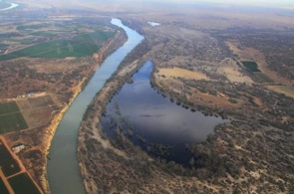
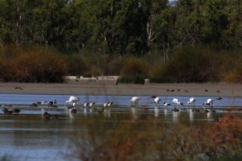
The Basin Plan – a process and
a platform of agreement
Goal of a healthy working river
Requires standards and targets to be met
Accompanied by very significant funding
It reduces risk

Slide 5
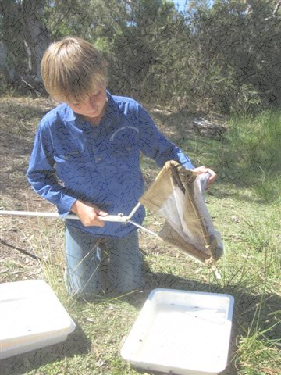
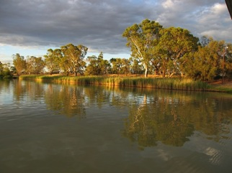
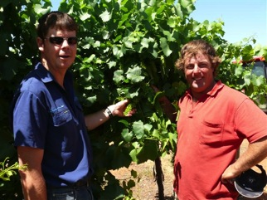
What are we doing ?
On farm irrigation efficiency programs and SARMS
Investment in wetland regulators
Working with community groups and individuals on water, land and wetland management

Slide 6
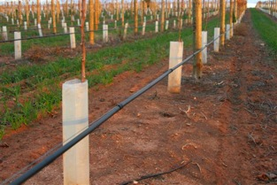
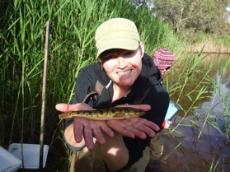
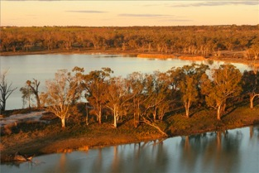
Transition of water to Commonwealth Environmental Water Holder
Improved operating rules
Next generation water allocation plans
Research and development – new crops, next generation irrigation practices

Slide 7
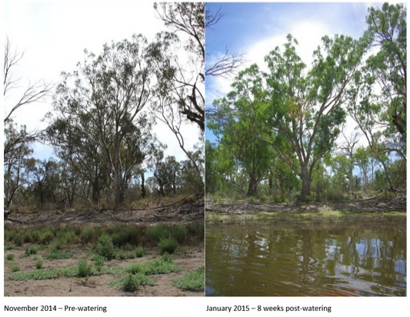
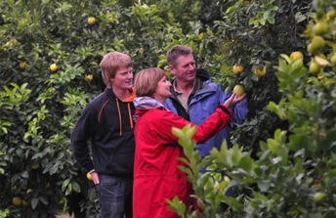
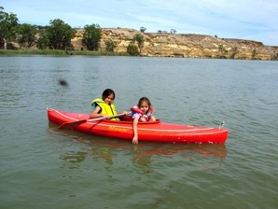
The Future
Ensuring Basin Plan delivered in full and on time
Monitoring, evaluating and adapting
Everyone needs to play their part

Slide 8
Thanks

